Slide 1


Multiple GraphHeat Networks for Structural to Functional Brain Mapping
July 20, 2022
IJCNN-2022
Subba Reddy Oota¹, Archi Yadav¹, Arpita Dash¹, Bapi Raju Surampudi¹, Avinash Sharma¹
¹IIIT-Hyderabad, India

Slide 2
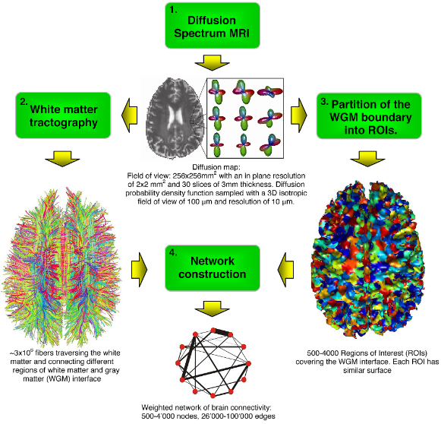
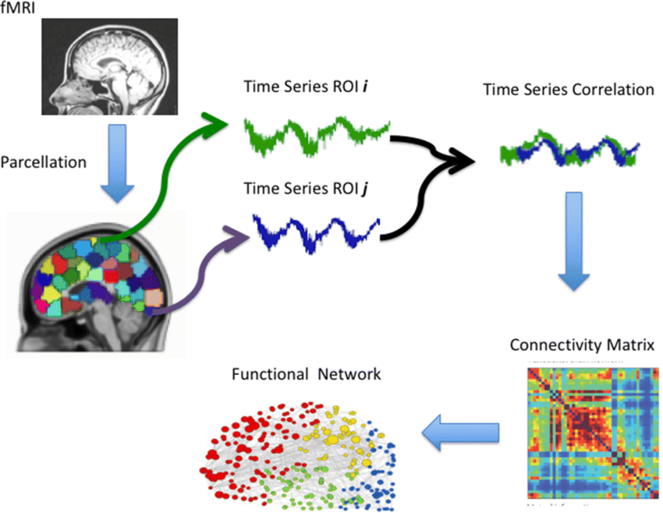
Introduction
The human brain’s structural topology is estimated from diffusion tensor images (DTI) to derive the structural connectivity (SC) matrix that summarizes the fiber connectivity density among the brain regions.
Functional connectivity (FC) among these regions is estimated by computing the correlation coefficient (usually Pearson) of the respective time-varying resting-state functional magnetic resonance imaging (rsfMRI) signals.
Hagmann et al. 2007, Milano et al. 2019

Slide 3
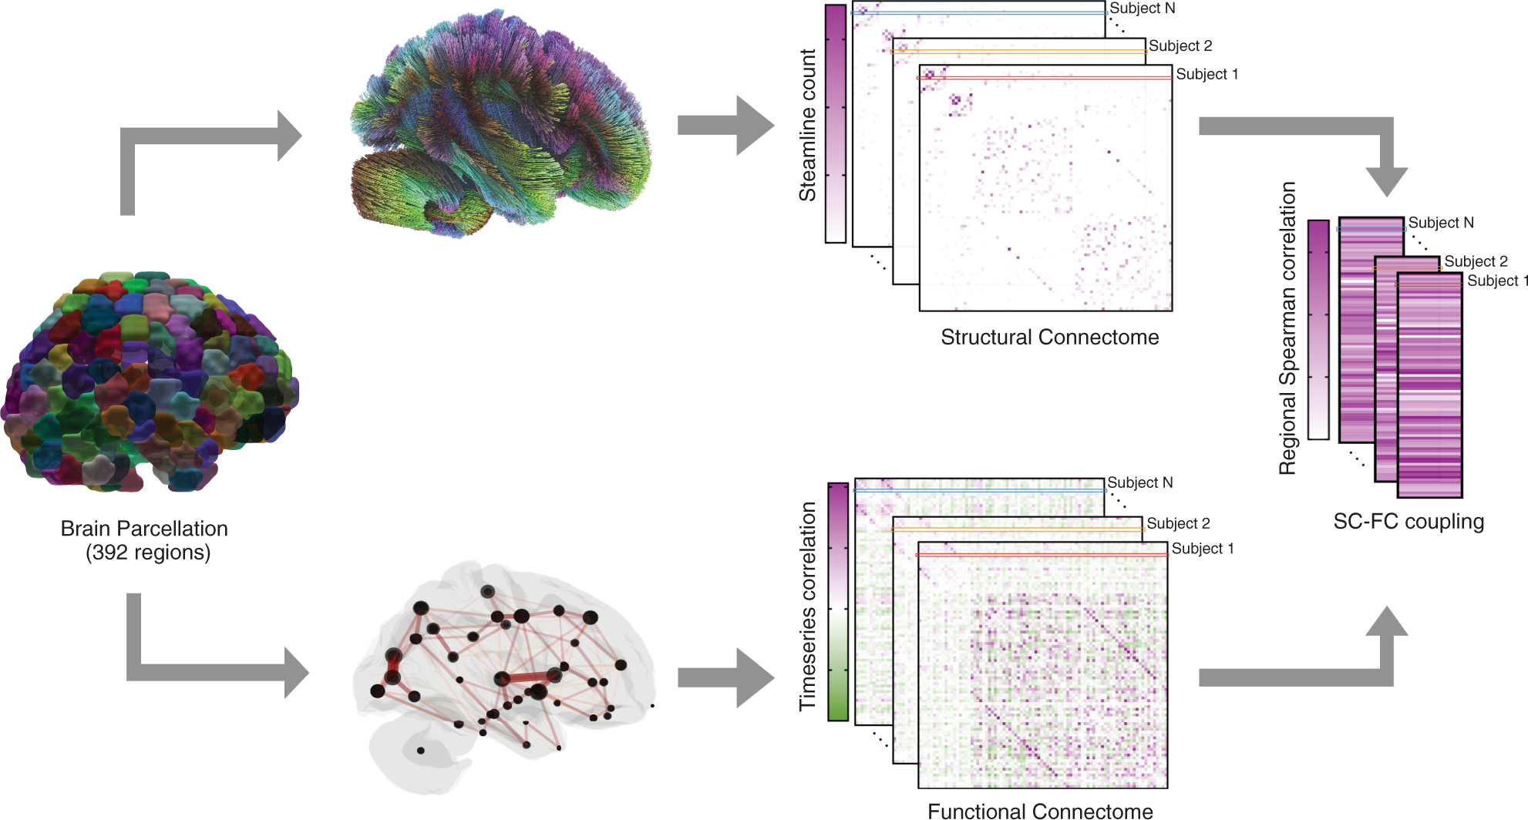
Why SC-FC mapping is important?
We can identify the biomarkers that underlie any deviation from the expected FC based on the SC in various diseases such as Autism Spectrum Disorder (ASD), Dementia, etc,.
Helpful to characterize the functional recovery patterns resulting from therapy comparing the FC observed with the predicted FC based on healthy structural topology.
Synder et al. 2018

Slide 4
Three popular SC-FC mapping methods
Whole Brain Modeling of SC-FC
Graph-theoretic Modeling using Linear Models
Deep Learning Models for SC-FC Mapping

Slide 5
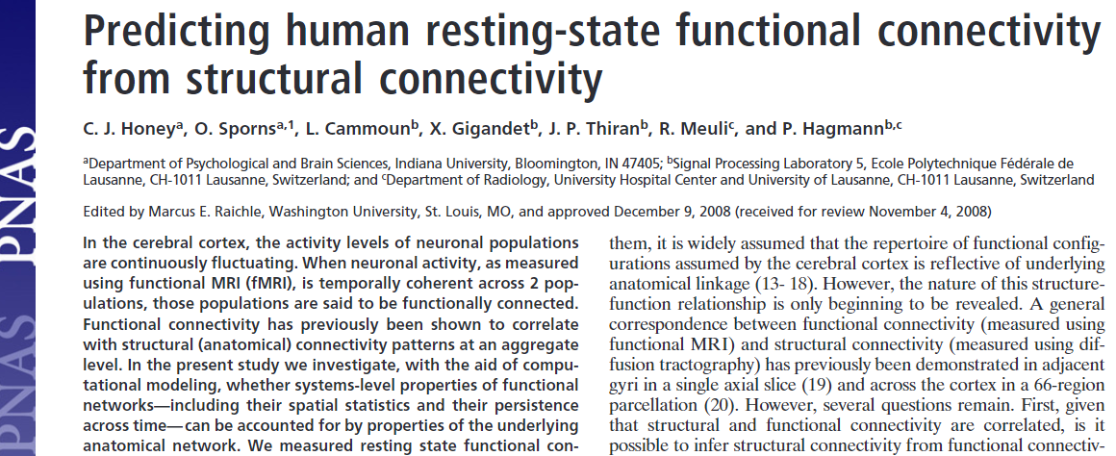
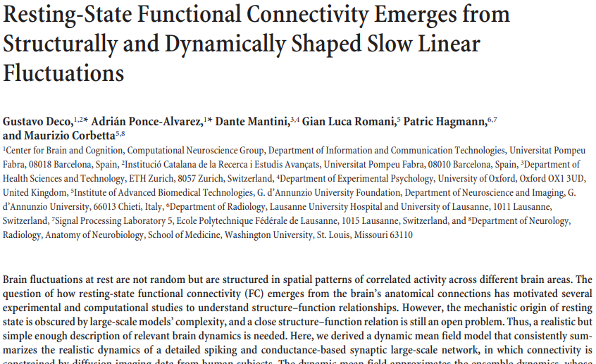
Whole Brain Modeling of SC-FC
Honey et al. 2009, Deco et al. 2013

Slide 6
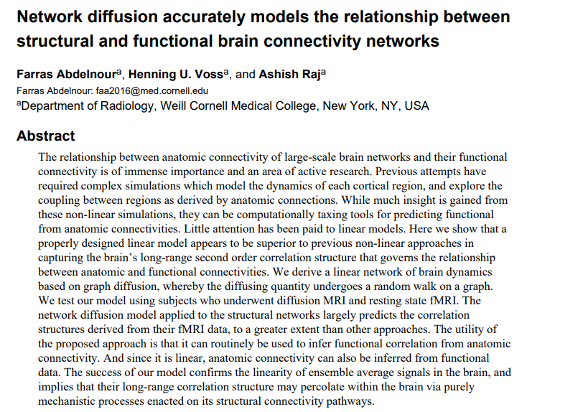
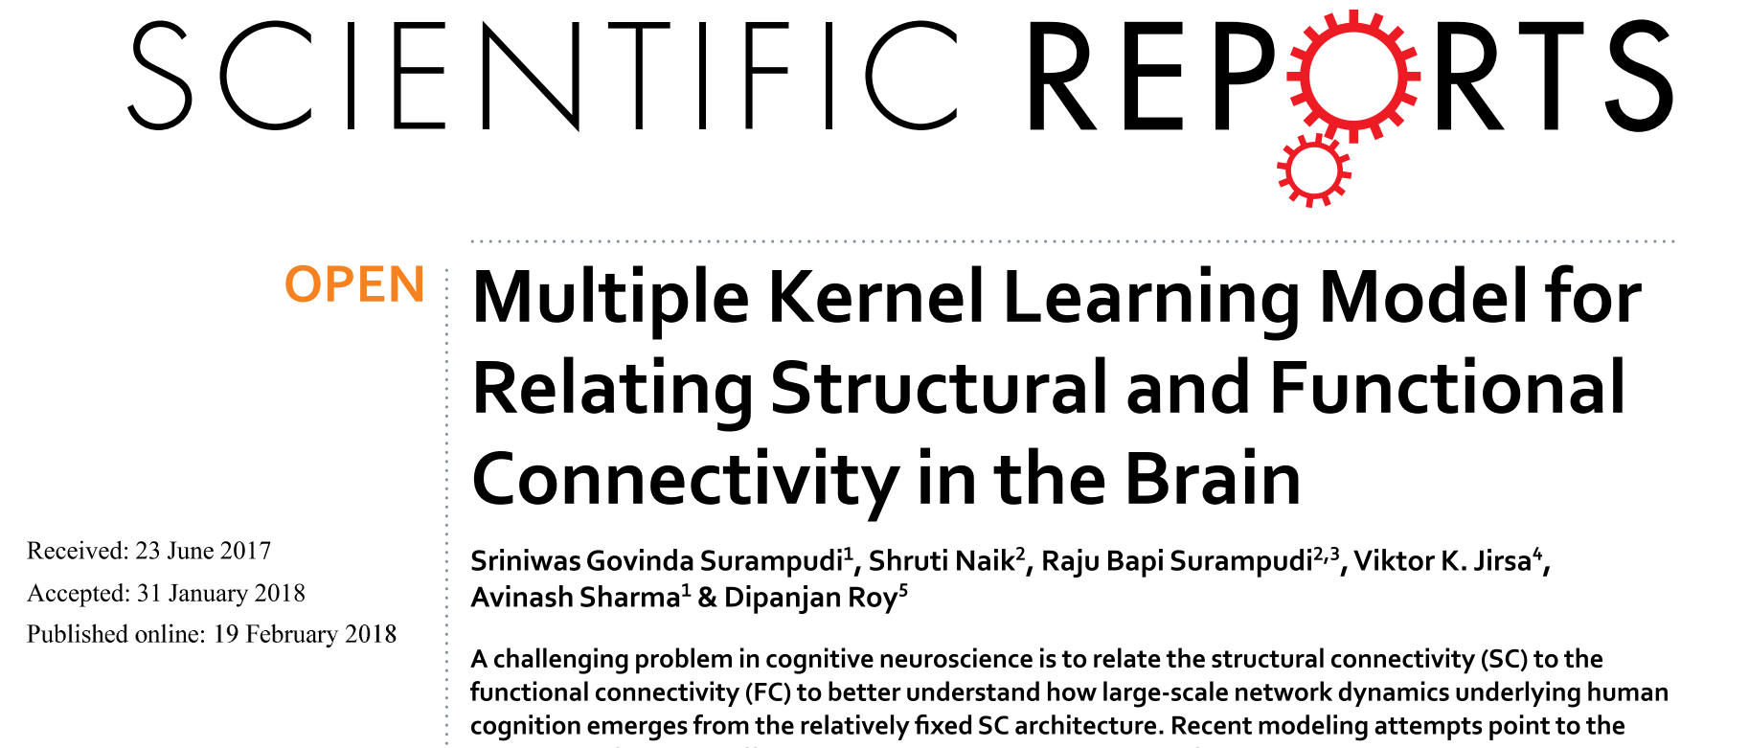
Graph-theoretic Modeling using Linear Models
Abdelnour et al. 2016, Surampudi et al. 2018

Slide 7
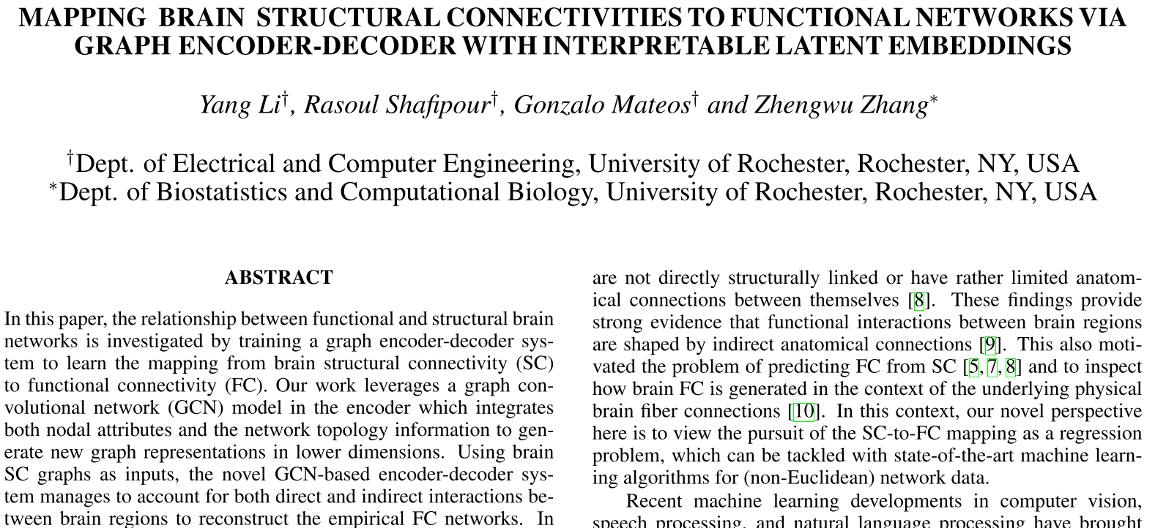
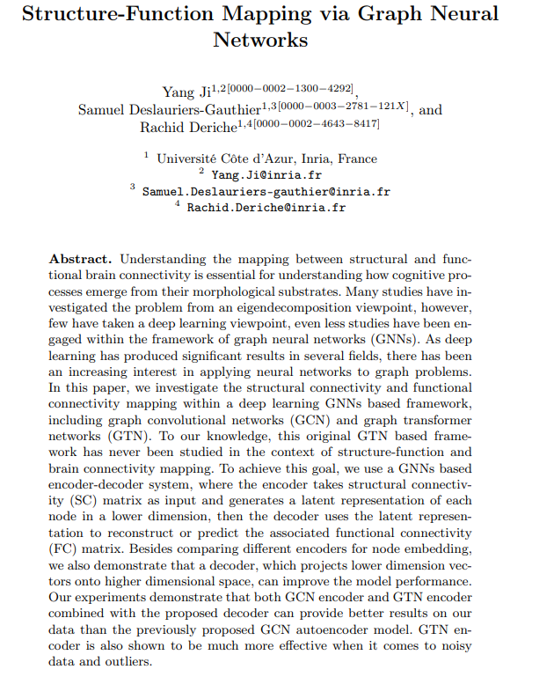
Deep Learning Models for SC-FC Mapping
Li et al. 2019, Ji et al. 2021

Slide 8
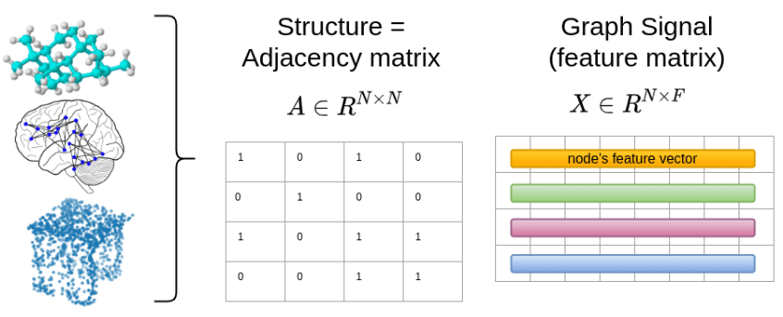
Why Graph Convolutional Networks (GCNs)?
Graphs are a super general representation of data with intrinsic structure.
We can represent brain graphs from functional medical imaging, social networks, point clouds, and even molecules and proteins.
Kipf et al. 2016

Slide 9
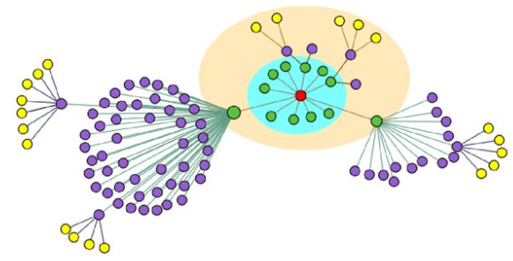
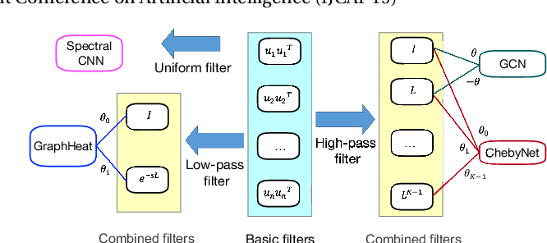
GraphHeat Networks
GCNs determine neighborhood according to the hops away from center node, i.e., in an order-style
Nodes in different colors
GraphHeat determines neighborhood according to the similarity function by heat diffusion over graph
Nodes in different circles
Heat Kernel Matrix

Slide 10
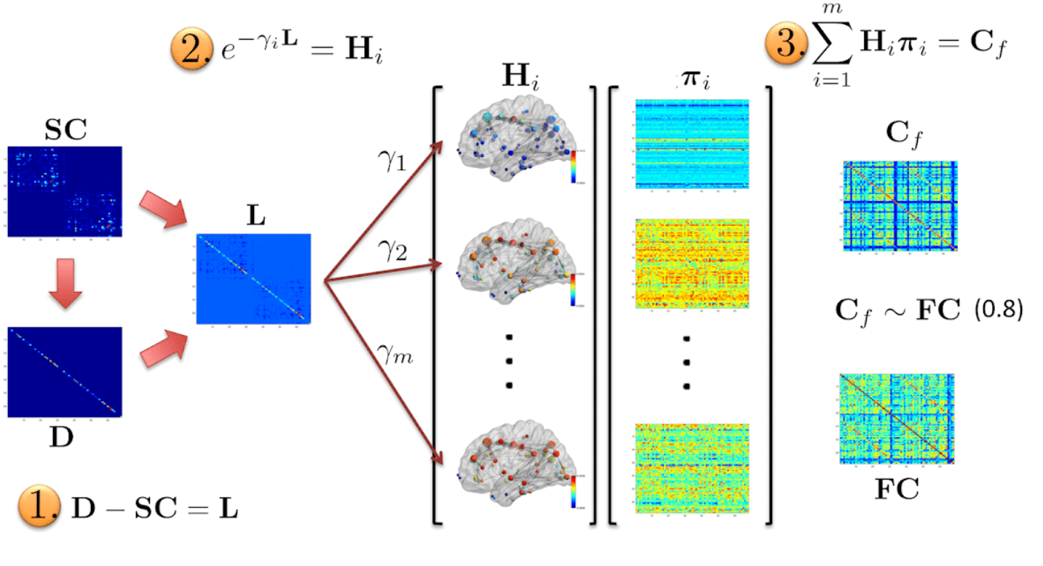
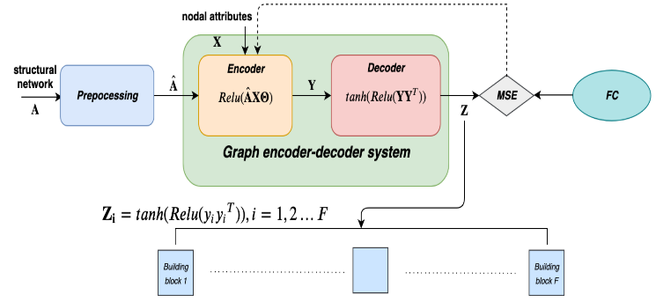
Motivation
Lasso Regression
H: Heat Kernels
Scale Values
A: Structual Matrix
FC: Functional Conntectivity Matrix
Z: Predicted FC
D: Degree Matrix
SC: Structural Conntectivity Matrix
L: Laplacian Matrix
Surampudi et al. 2018, Li et al. 2019

Slide 11
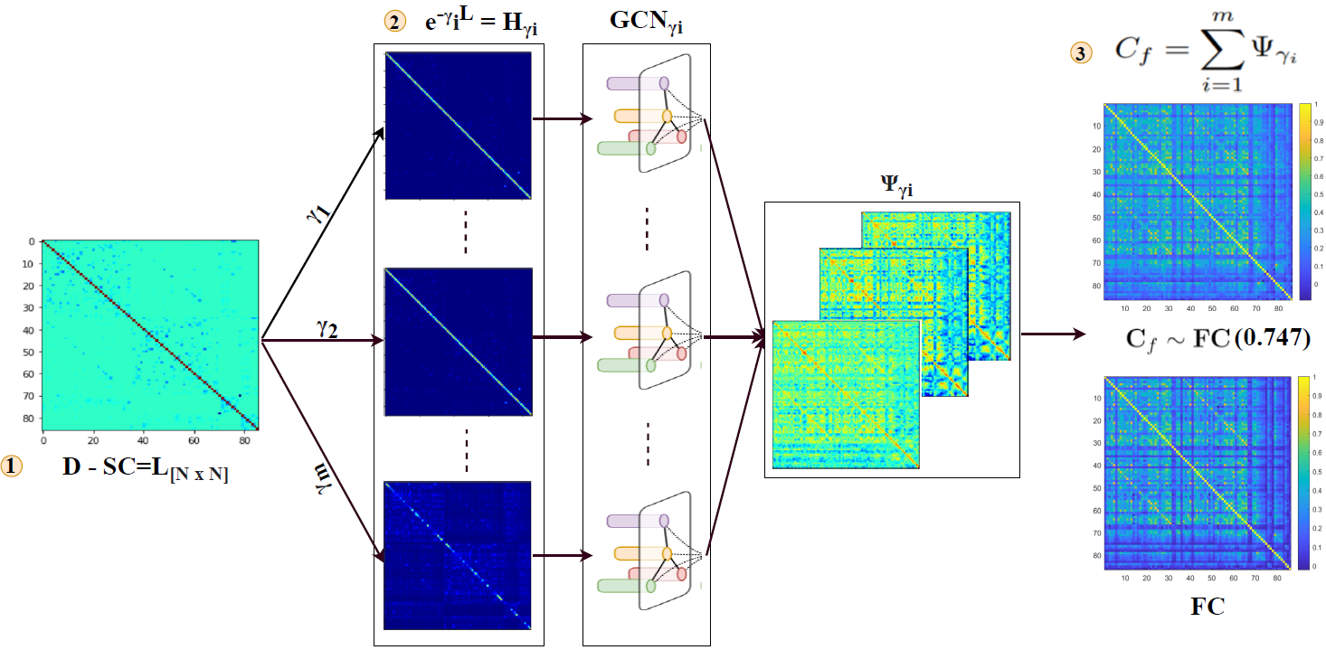
M-GHN Architecture
H: Heat Kernels
GCN Models
GCN Outputs
Scale Values
D: Degree Matrix
SC: Structural Conntectivity Matrix
Correlation
Laplacian Matrix

Slide 12
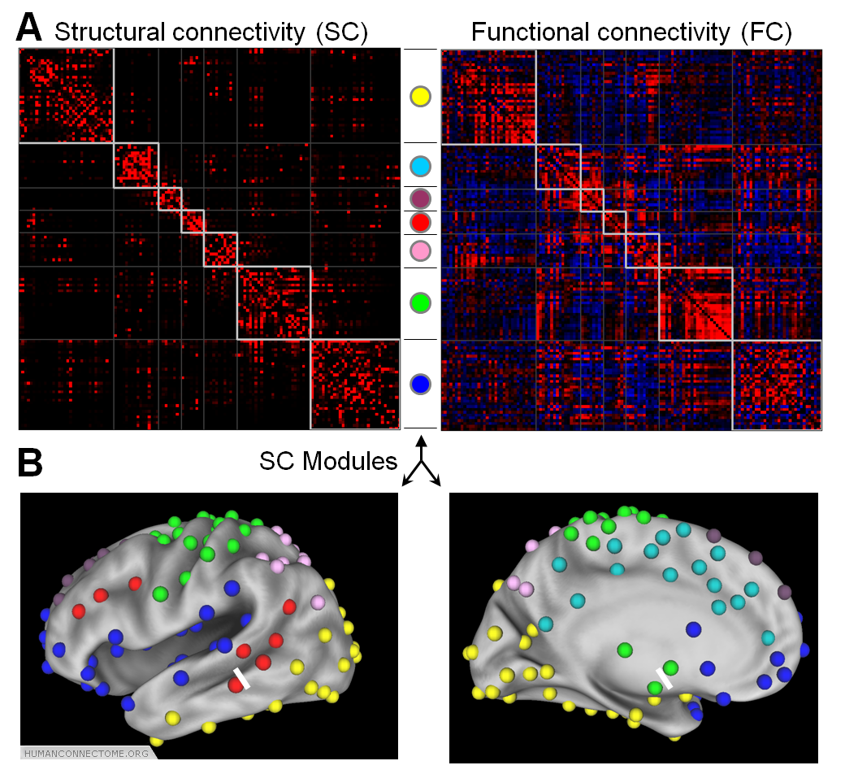
HCP Dataset
100 subjects of SC – FC paris from the HCP repository.
Participants underwent resting-state functional imaging (no task condition) with their eyes closed.
The blood oxygen level dependent (BOLD) time-series signal available for each participant has 1200 time points aggregated across 86 regions of interest (ROIs) as per the AAL brain atlas.
Bullmore et al. 2009, Dosenbach et al. 2008

Slide 13
Experimental Setup
Three experimental settings
Randomly sampled 50 subjects (45 – training, 5 – validation), and remaining subjects used for testing.
Leave-one-out-crossvalidation
5-fold crossvalidation

Slide 14
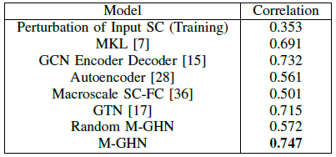
Comparison of M-GHN with previous methods
Add noise to input SCs during training while correct SCs in testing
The Pearson correlation between the ground-truth FC and predicted FC of test subjects.
Multi-layer perceptron as encoder-decoder model.
GNNs (GCN + GTN)

Slide 15
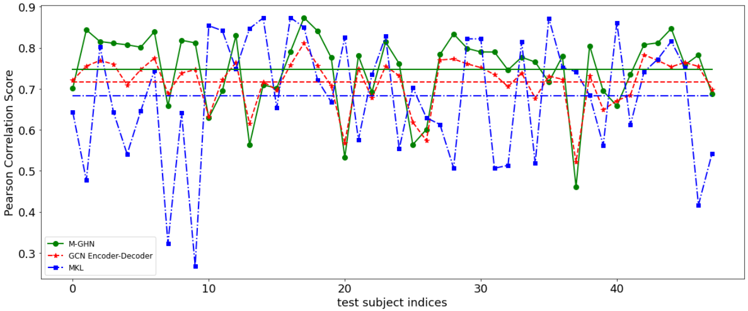
Results: Randomly sampled experiment

Slide 16
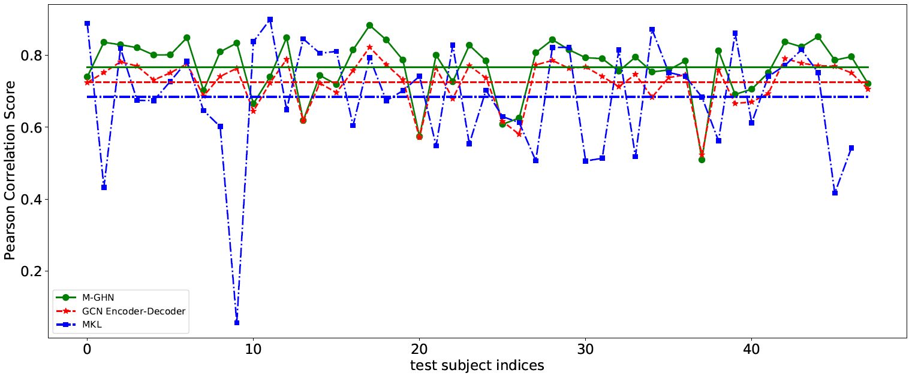
Results: LOOCV

Slide 17
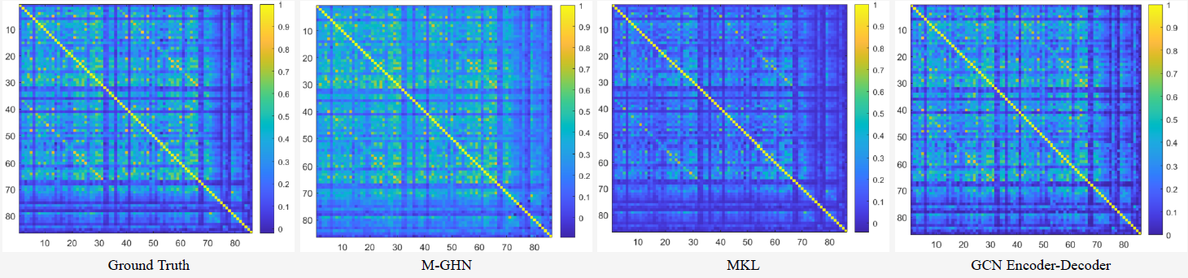
Qualitative Analysis: Functional Connectivity matrices (FCs).
mean of the test FCs
mean of the predicted FCs of each model

Slide 18
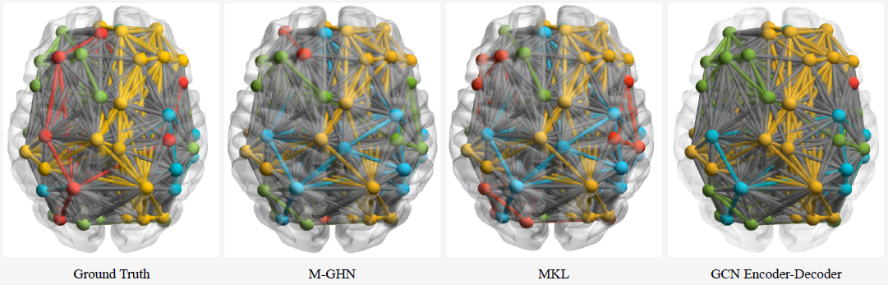
Qualitative Analysis: Functional Connectivity Networks.
Each color indicates the nodes in that particular community

Slide 19
Discussion
We adopt the representation of the graph signal in terms of graph heat kernel.
The proposed M-GHN method is grounded in the theory of the reaction-diffusion process in the cognitive domain.
Proposed M-GHN model displays superior performance as compared to baseline models such as GCN Encoder-Decoder, MKL model, and previous state-of-the-art methods.
The M-GHN model is easily scalable to any brain parcellation (for example, Gordon Atlas with 333 × 333, Glasser Atlas with 360 × 360 parcellations).
Also, the MGHN model requires learning of 51,772 parameters (7 scales: 7x7396) that is comparatively lower than learning 118,336 parameters in the MKL framework (16 scales: 16x7396).
Further, the proposed framework is inherently scalable to more diffusion scales, more hidden layers in the GHNs, and can potentially be used for transfer learning on other datasets.

